Slide 1
Molecular replacement in CCP4
Andrey Lebedev
CCP4
Notes:
This talk more about twinning and there are many overlaps with what Sbyscec was talking about yesterday
I want to highlight several important practical points

Slide 2
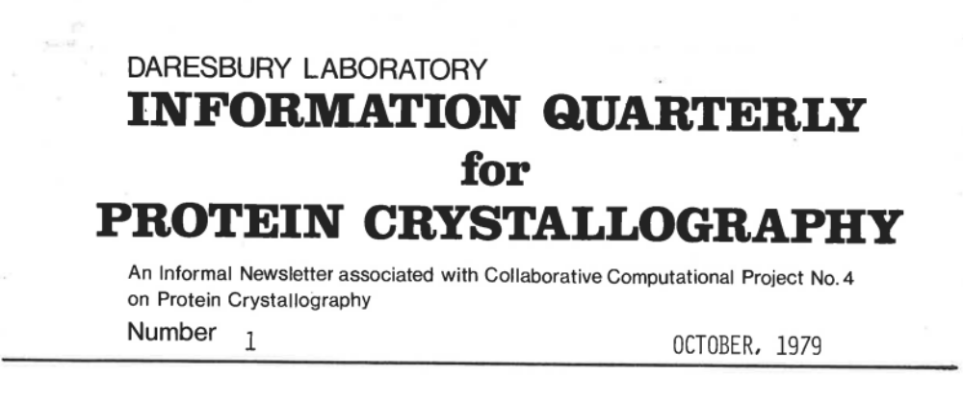
Daresbury -1979

Slide 3
Collaborative Computational Project No. 4
The CCP4 Project was established in 1979 funded by UK Research Council
Project aims
  Encourage collaborative development of software in macromolecular crystallography.
  Provide software for all the steps of macromolecular crystallography.
  Promote the teaching of macromolecular crystallography
  Provide a graphical user interface for organisation and guidance (CCP4i).

Slide 4
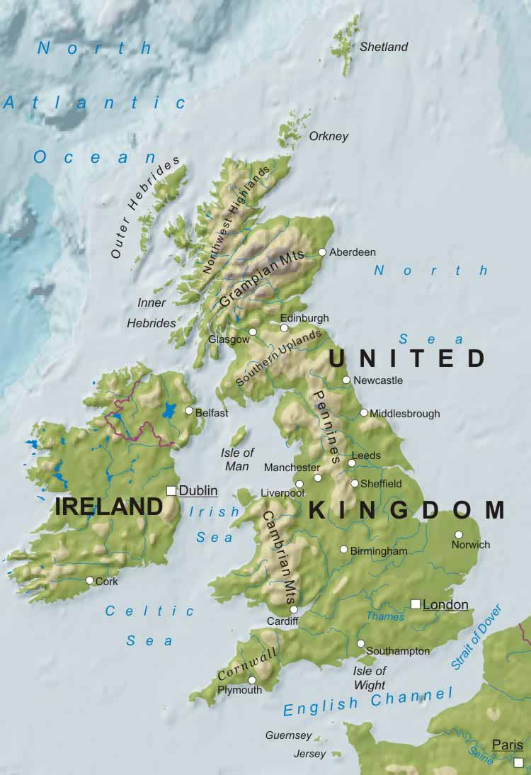
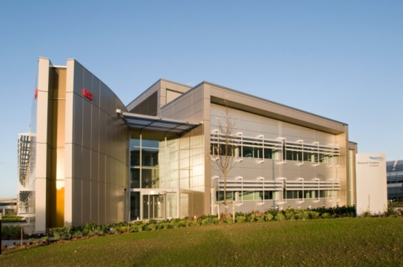

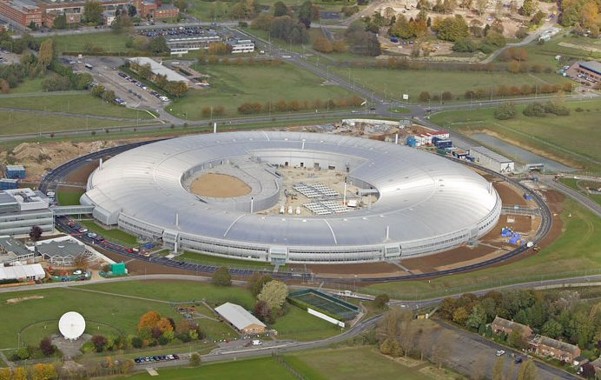
Part of the the Science and Technology Facilities Council (STFC)
Hosted by the Research Complex at Harwell (RCaH) next door to Diamond
CCP4 funded by:
  Biotechnology and Biological Sciences Research Council (BBSRC)
  Medical Research Council (MRC)
  Industrial funding
CCP4

Slide 5
Core Group (Harwell Oxford):
  Maintain software suite
  Automation and infrastructural developments
  Collaborate with Diamond on software deployment on the beamline
  Educational outreach
  Maintaining CCP4 resources such as the CCP4 bulletin board, helpdesk, newsletters
Cambridge:
  Laboratory of Medical Biology
    Data processing software - Mosflm, Aimless
    Refinement software – Refmac
    Model building - Coot
  University of Cambridge
    Phaser group
University of York:
  Software development – CCP4mg, Buccaneer, Parrot
  CCP4 GUI2 development
Leiden in the Netherlands
  Crank group
York
Liverpool
Cambridge
Harwell

Slide 6
Molecular Replacement in CCP4
AmoRe
Jorge Navaza IBS Grenoble
Molrep
Alexey Vagin University of York
  Phaser
  Randy Read University of Cambridge
  Airlie McCoy University of Cambridge
  Gabor Bunkozci University of Cambridge

Slide 7
Molecular Replacement in CCP4
Balbes
Alexey Vagin University of York
Fei Long MRC LMB
Garib Murshudov MRC LMB
MrBUMP
Ronan Keegan STFC RAL
Martyn Winn STFC DL
Ample
Ronan Keegan STFC RAL
Jaclyn Bibby University of Liverpool
Daniel Rigden University of Liverpool
Olga Mayans University of Liverpool

Slide 8


Molecular Replacement
Gábor Bunkóczi

Slide 9
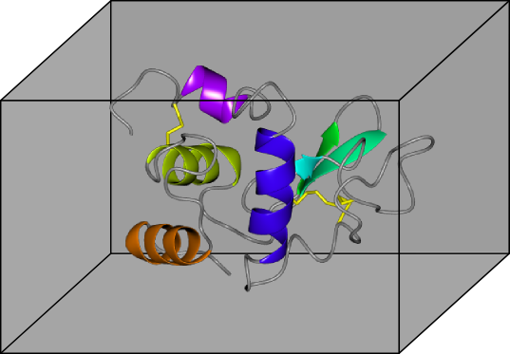
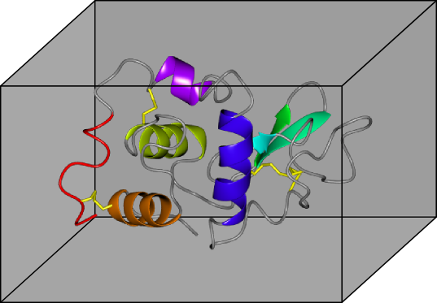
Two similar structures
h | k | l | F | φ
0 | 0 | 1 | 12.6 | 123
0 | 0 | 2 | 2.1 | 12
0 | 0 | 3 | 69.9 | 287
h | k | l | F | φ
0 | 0 | 1 | 10.4 | 113
0 | 0 | 2 | 3.5 | 18
0 | 0 | 3 | 57.2 | 265

Slide 10
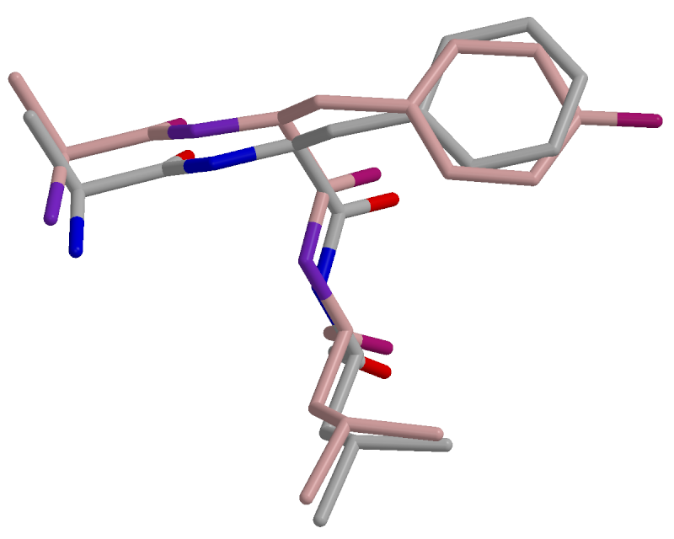
Model error
Position errors
Model incompleteness

Slide 11
Probability density of F_{obs}
(given model and parameters characterising model errors)
F_{obs} is the structure factor from the TRUE structure
DF_{c}
F_{obs}
|F_{obs}| is observed
F_{obs} is distributed normally about DF_{C}

Slide 12
Probability density of F_{obs}
F_{c} – model structure factor Dependent on orientation and position of model
F_{c}
σ_{Δ}
D – Luzzati-factor (0 ≤ D ≤ 1)
Dependent on model
errors
σ_{Δ} – uncertainty
Dependent on model
errors and incompleteness
DF_{c}

Slide 13
Probability density of |F_{obs}|
(given model etc.)
= Likelihood function
Rice distribution
Used in refinement
|F_{obs}|

Slide 14
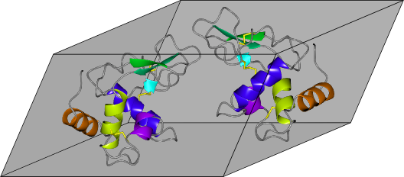
MR Problem
Previous crystal form
Current crystal form
Required: a score for each model
of Current crystal form
Phaser: Likelihood Function

Slide 15
Likelihood of |F_{obs}|
(given R₃, r₃, D, σ_{Δ})
DF_{c}(R₁, r₁)
|F_{obs}|
(R₁, r₁)

Slide 16
Likelihood of |F_{obs}|
(given R₃, r₃, D, σ_{Δ})
|F_{obs}|
DF_{c}(R₂, r₂)
(R₁, r₁)
(R₂, r₂)

Slide 17
Likelihood of |F_{obs}|
(given R₃, r₃, D, σ_{Δ})
|F_{obs}|
DF_{c}(R₃, r₃)
(R₁, r₁)
(R₂, r₂)
(R₃, r₃)

Slide 18





Brute search
Calculate likelihood for each gridpoint
…

Slide 19

Brute search
Calculate likelihood for each gridpoint
…
Find peaks

Slide 20


Fast search
Calculate approximation by FFT
Peak search
Rescore with likelihood

Slide 21
Fast search
Back to classical MR? Not quite
Advantages of using Likelihood approach
Final scoring is the most robust
Maximum consistency between preliminary and final scoring
A way to push boundaries of the method

Slide 22
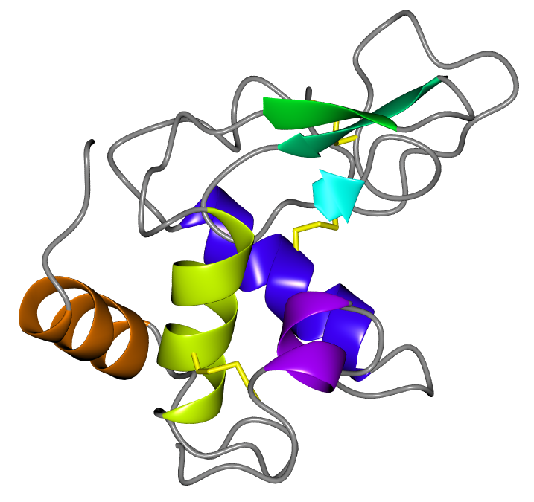
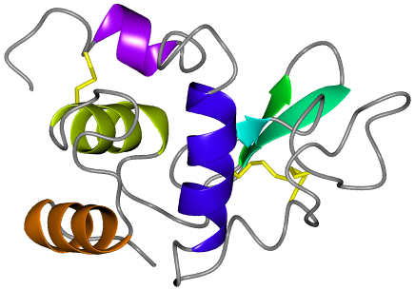
Separability
+
(φ, ψ, κ)
(x, y, z)

Slide 23
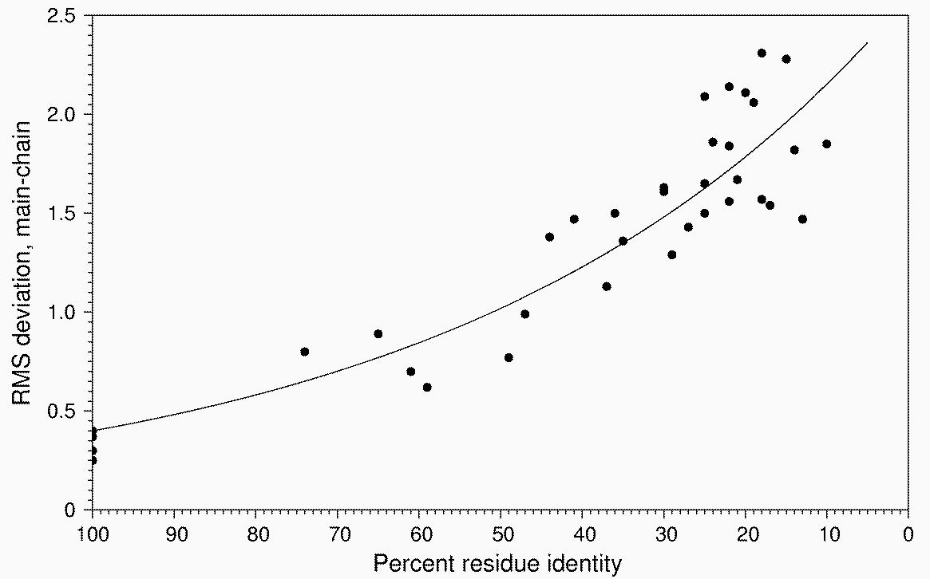
Model error
Calculate from sequence identity
(Chothia & Lesk)
Position errors
Model incompleteness
Calculate from unit cell composition

Slide 24
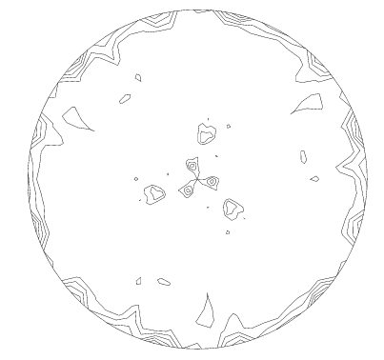

Rotation search
⇒ Typically small signal
⇒ Dependent only on the point group

Slide 25
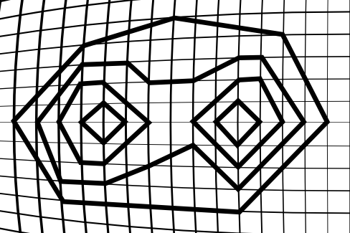
Rotation peaks
Centre of coalesced peak
Peak
Peak
Translation function is very sensitive to orientation and may not find a solution in such a case!

Slide 26

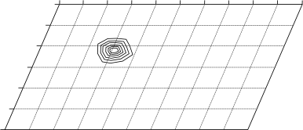
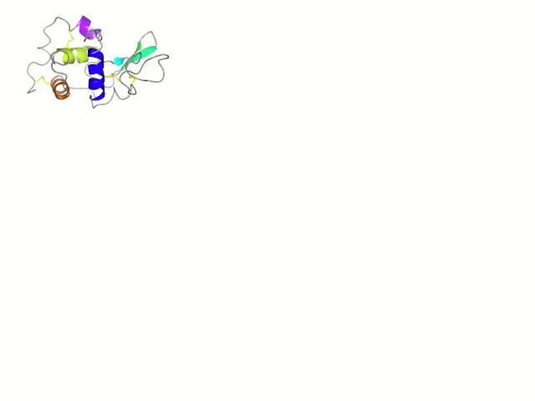
Translation search
⇒ Solutions are recognizable (high Z-score)
⇒ Very sensitive to correct orientation

Slide 27
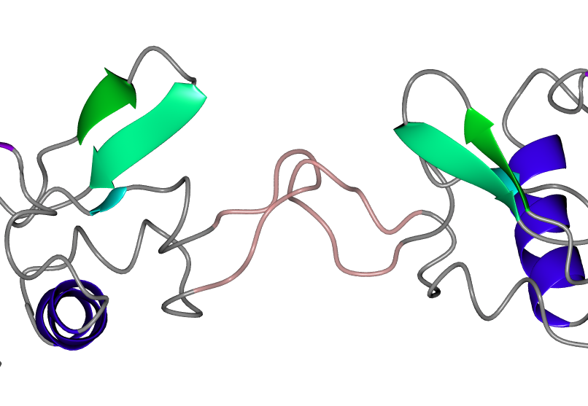
Packing
Clashes between models decrease credibility in solution

Slide 28
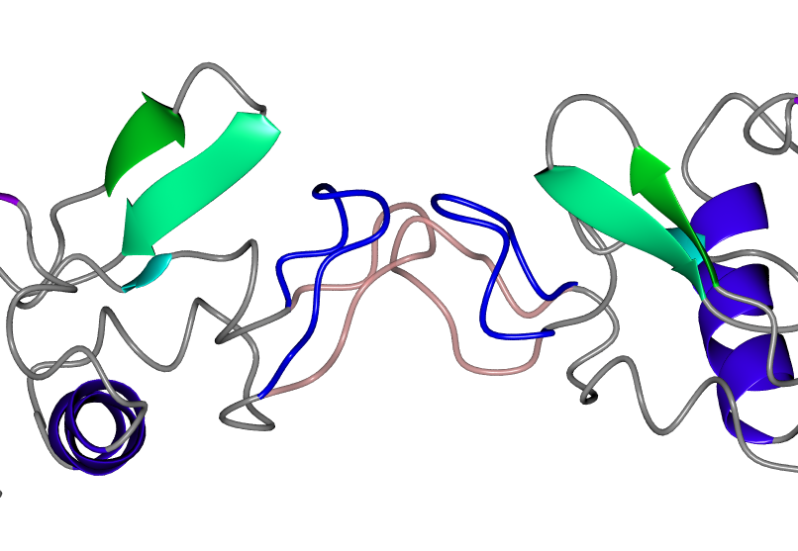
Packing
Surface loops may change conformation

Slide 29
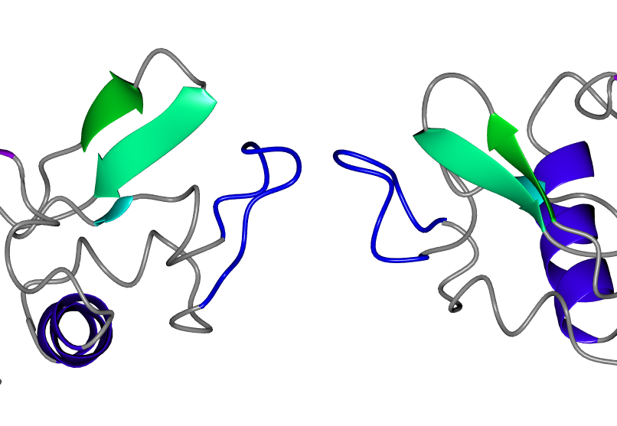
Packing
A small number of clashes is acceptable

Slide 30
Refinement
The rotation and translation functions were performed on a (not very fine) grid
The solution can be improved if the grid is taken away and the rotational and translational parameters optimized

Slide 31
Identifying solutions
TFZ
2
3
4
5
6
7
8
9

Slide 32
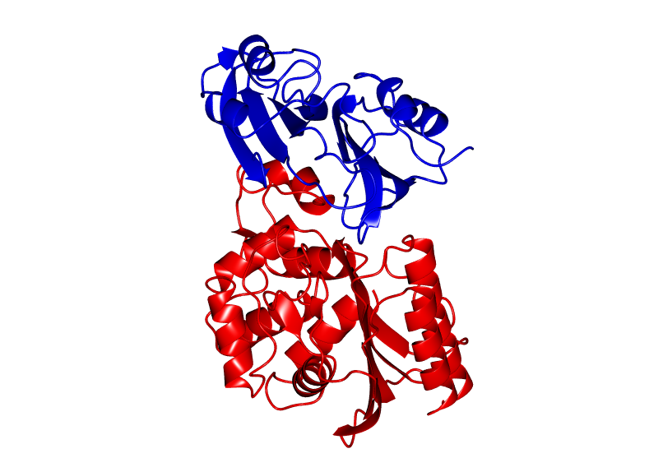
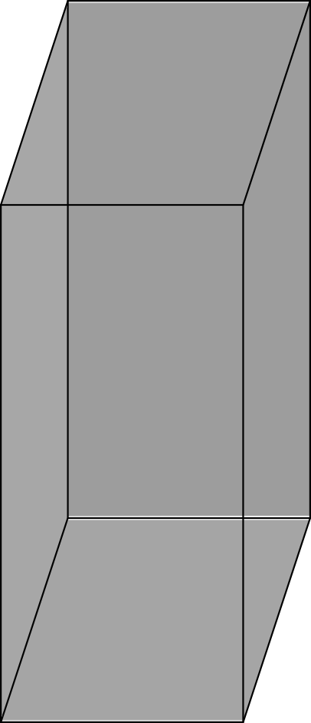
Partial structure
?

Slide 33
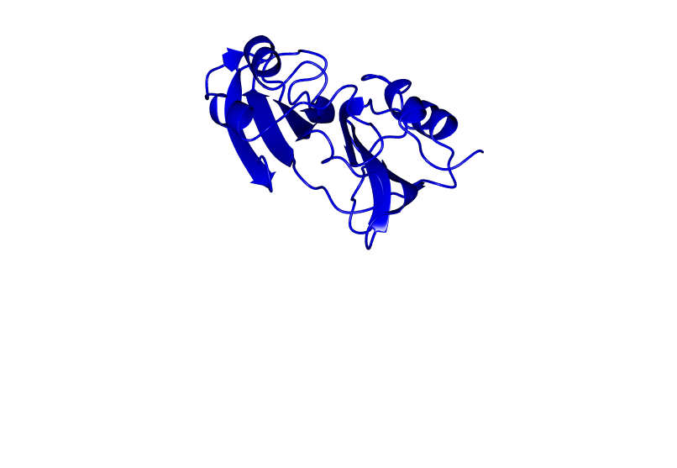
Partial structure

Slide 34
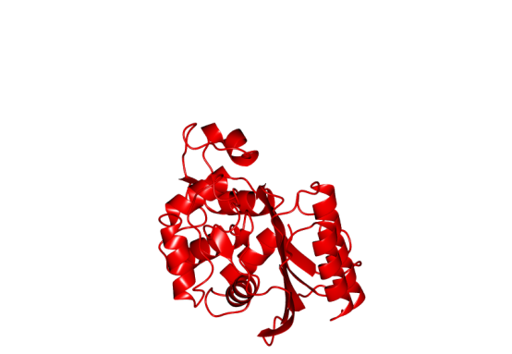
Partial structure
Notes:
Make a note of

Slide 35
Model search order
Better model if data resolution is low
65% of structure
35% identical model
Better model if data resolution is high
35% of structure
50% identical model
Determined automatically!

Slide 36
Tree search with pruning
1st component
Pruned
Propagated
Perform search
2nd component

Slide 37
Molrep
Alexey Vagin
YSBL University of York

Slide 38
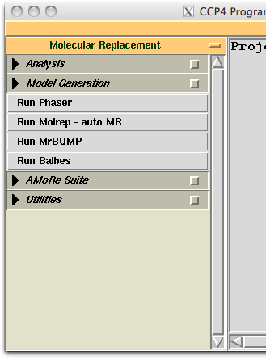
Molrep
molrep -f data.mtz -m model.pdb -mx fixed.pdb -s target.seq

Slide 39
Default protocol
molrep -f data.mtz -m model.pdb -mx fixed.pdb -s target.seq
  model correction if sequence provided
  defines the number of molecules per AU
  modification of the model surface
  anisotropic correction of the data
  weighting the data according to model completeness and similarity
  check for pseudotranslation and use it if present
  30+ peaks in Cross RF for use in TF (accounts for close peaks)
  applied packing function
  make use of partial structure (fixed model)
Notes:
blah: do not whant to talk much about this
go through log-file and see what is there

Slide 40
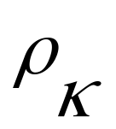
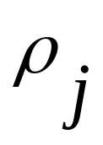
Fast Packing Function
Estimation of overlap
  Using mask from search model
  FFT
Packing Function
    PF = 1 – overlap
Modified Translation Function
    TF' = TF × PF
Peak search
  Using TF'
  No irrelevant peaks are passed to rescoring step

Slide 41
Molrep protocols for two copies of a model
X-ray data
all steps
Search model
RF
TF * PF
Rescoring
Partial structure
TF * PF
Rescoring
Possible solution
RF = ∑_{hkl} w * I_{O}* I_{C}(αβγ)
TF = ∑_{hkl} w * I_{O}* I_{C}(xyz)
Rescoring: Correlation Coefficient* PF

Slide 42
Using external refinement program
Partial structure
Search model
Refmac
Map coefficients
Molrep
Extended model
Search in the map
  Calculate 2-1 or 1-1 maps after restrained refinement of partial structure
  Flatten the map corresponding to the known substructure
  Calculate structure amplitudes from this map
  Use these modified amplitudes in Rotation Function
      Theoretically quite similar to RF with fixed model
  And finally – Phased TF

Slide 43
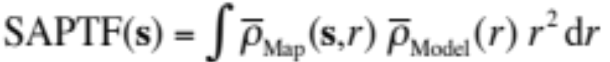





SAPTF
Spherically Averaged Phased Translation Function
(FFT based algorithm)
Notes:
Here: about search in the density in general
"Back to the general problem of searching in the density"

Slide 44
Search in the map with SAPTF
1. Find approximate position:
    Spherically Averaged Phased Translation Function
2. Find orientation:
    Local Phased Rotation Function
      Local search of the orientation in the density
3. Verify and adjust position:
    Phased Translation Function
Notes:
Here: about search in the density in general

Slide 45
Search in the map with SAPTF
1. Find approximate position:
    Spherically Averaged Phased Translation Function
2. Find orientation:
    Local Rotation Function
      Structure amplitudes from the density within the SAPTF sphere
3. Verify and adjust position:
    Phased Translation Function
  Local RF is less sensitive than Phased RF to inaccuracy of the model position
Notes:
Here: about search in the density in general

Slide 46
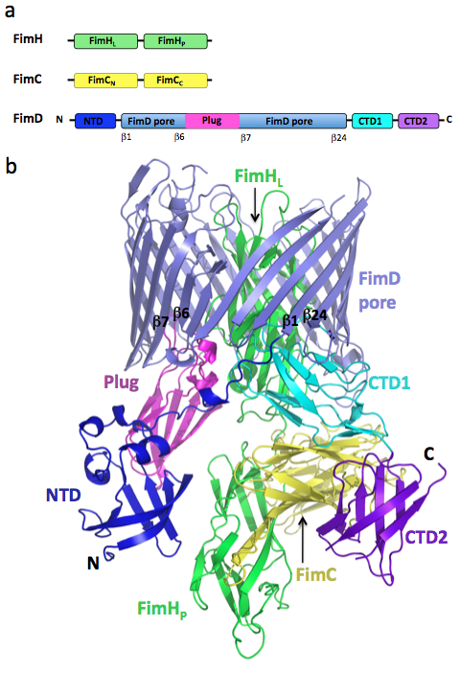
Example
  Asymmetric unit two copies
  Resolution 2.8 Å
Phane et. al (2011) Nature, 474, 50-53

Slide 47
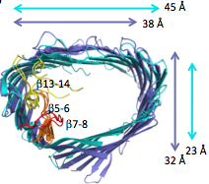
Usher complex structure solution
1. Conventional MR
      FimC-N + FimC-C
      FimH-L + FimH-P
      FimD-Pore
2. Jelly body refinement (Refmac)
      FimD-Pore
3. Fitting into the electron density
      FimD-Plug
      FimD-NTD
      FimD-CTD-2
4. Manual building
      FimD-CTD-1
Notes:
Essential steps of strcture solution, and, particularly, what we are interested in, the fitting into the density

Slide 48
Performance of fitting methods
 | search model | sequence identity | "Masked" RF PTF prf n | SAPTF PRF PTF prf y | SAPTF Local RF PTF prf s
FimD-Plug | 3fip_A | 38.5% | 2 (2) | – (–) | 1 (2)
FimD-NTD | 1ze3_D | 100% | 2 (2) | 1 (2) | 2 (2)
FimD-CTD-2 | 3l48_A | 33.3% | – (–) | 2 (2) | – (–)
Trying several methods is a good practice (also because of cross-validation)
Notes:
Essential steps of strcture solution, and, particularly, what we are interested in, the fitting into the density
Series of slides with pictures?

Slide 49
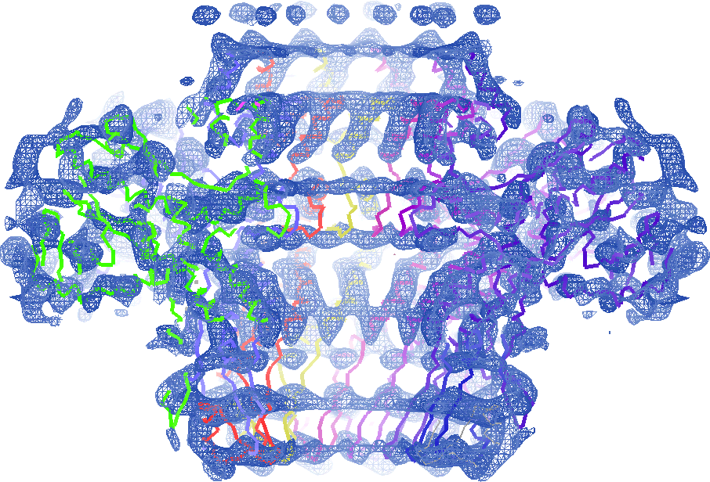
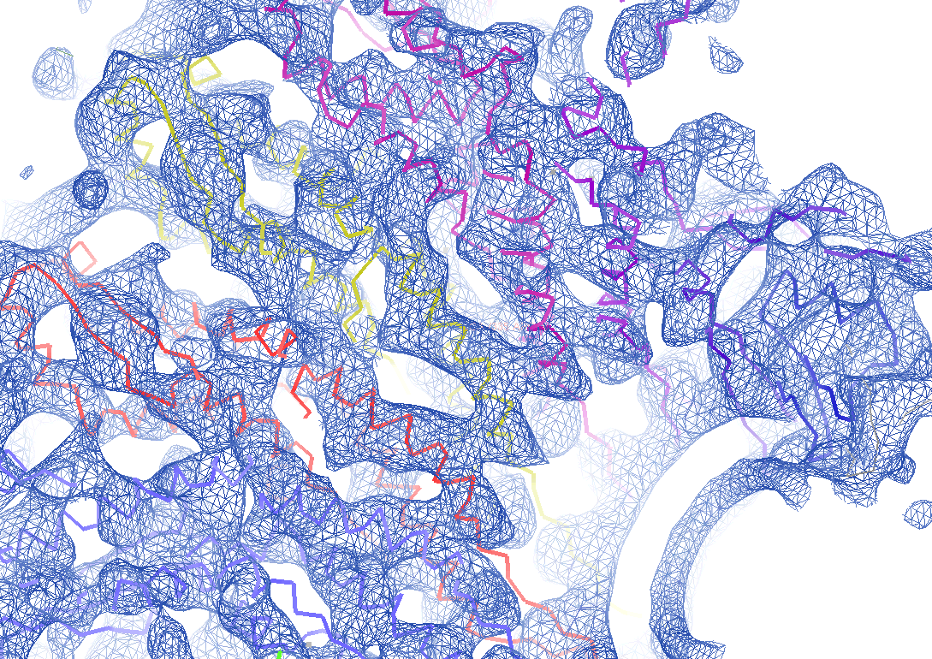
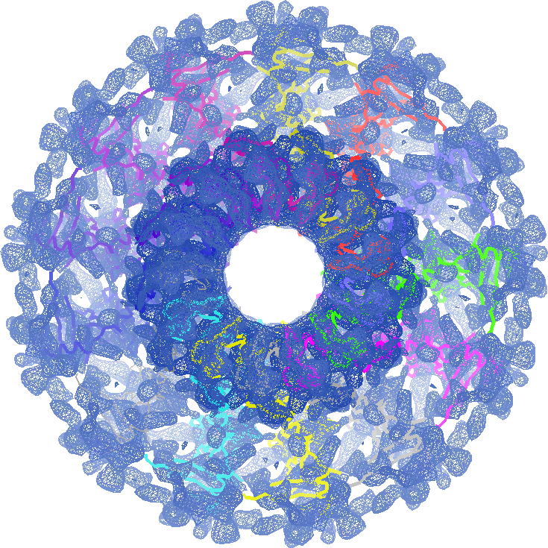
Fitting into EM maps

Slide 50
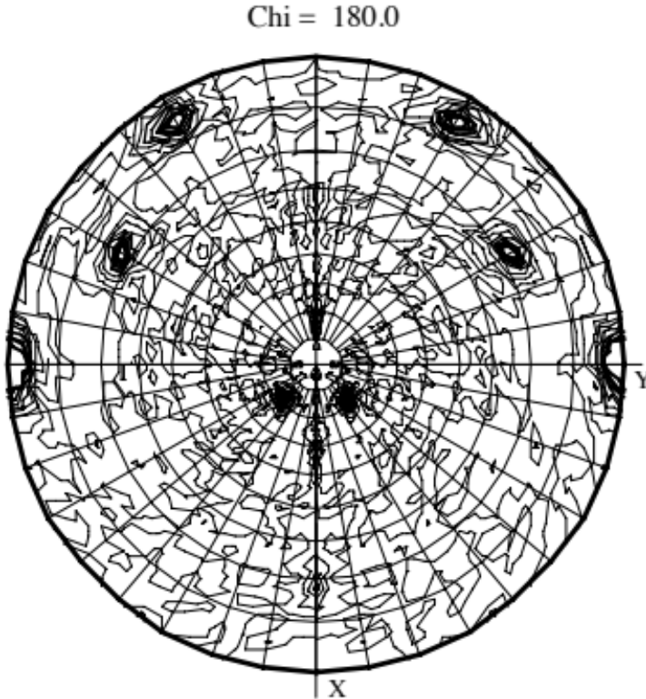
Self Rotation Function (SRF)
Preliminary analysis of X-ray data
  Oligomeric state of the protein in crystal
  Selection of oligomeric search model
Limited use
  Normally, no clear peaks in high symmetry space groups (e.g. P622)
  artifacts in SRF because of twinning
  different oligomers with the same symetry
Y
Chi = 180°
X
Example of SRF
  Space group P21
  One 222-tetramer in the AU
Notes:
In words:
A single outlier may corrupt SRF
LMIN controls harmonics of low order

Slide 51
Locked Rotation Function
  Uses SRF to derive NCS operations
  Averaging of RF over NCS
  In favorable cases Improves signal to noise ratio in RF
Y
Chi = 180°
X
Example of SRF
  Space group P21
  One 222-tetramer in the AU
Notes:
In words:
A single outlier may corrupt SRF
LMIN controls harmonics of low order

Slide 52
Locked RF
Locked Rotation Function
  Averaging of RF over NCS
  In favourable cases Improves signal to noise ratio in RF
Automatic mode
Using selected peaks from SRF
molrep -f s100.mtz -m monomer.pdb -s s100.seq –i <<+
lock y
+
molrep -f s100.mtz -m monomer.pdb -s s100.seq –i <<+
lock y
file_tsrf molrep_srf.tab
nsrf 1
+

Slide 53
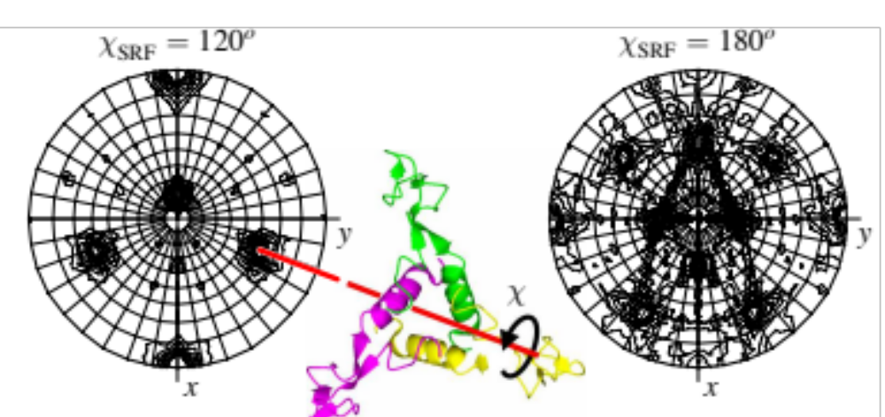
One-dimensional exhaustive search (exotic case)
SRF helps restrict dimensionality in an exhaustive search
  Orientation of the ring is known from the analysis of SRF
  Unknown parameter: rotation about 3-fold axis
  One-parametric exhaustive search using TF as score function

Slide 54
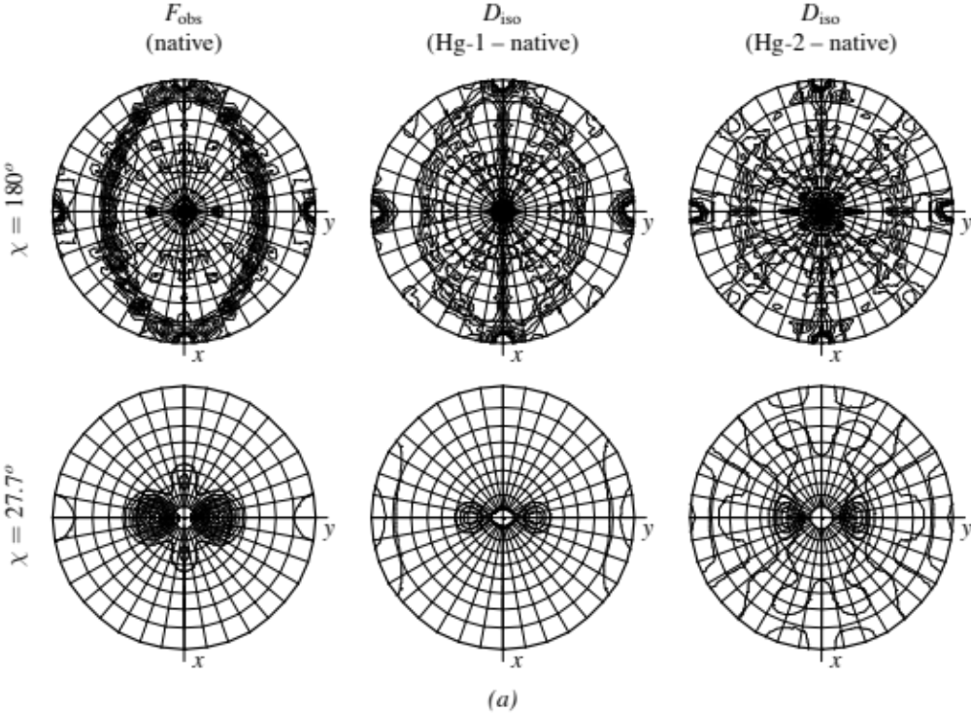
MR substructure solution (exotic case)
  Select isomorphous derivative
      by comparing native SRF and SRF from D-iso
  Hg-substructure is a 13-atom ring (from native SRF analysis)
      Orientation of the ring is known from the analysis of SRF
      Unknown parameters: radius of the ring, rotation about 13-fold axis
  Two-parametric exhaustive search

Slide 55
Where MR goes?
Automation. Therefore:
✖ Collection of tricks
✔ Improvement of general methods
✔ Better scoring system
✔✔ Models

Slide 56

Model improvement
Structural information in MR models
Extra information in sequence alignment
Improve model by removing
residues that are not present or significantly different in the target

Slide 57
Correcting for insertions
CHAINSAW
Sculptor
HCYKS------GIQVR
HCVNSYQSNLDAIKIR
profile-profile sequence-based alignment

Slide 58
Correcting for deletions
CHAINSAW
Sculptor
HCVNSYQSNLDAIKIR
HCYKS------GIQVR
profile-profile sequence-based alignment

Slide 59
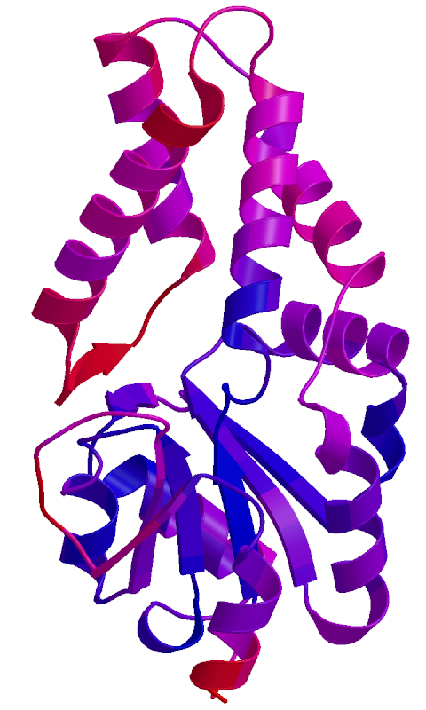
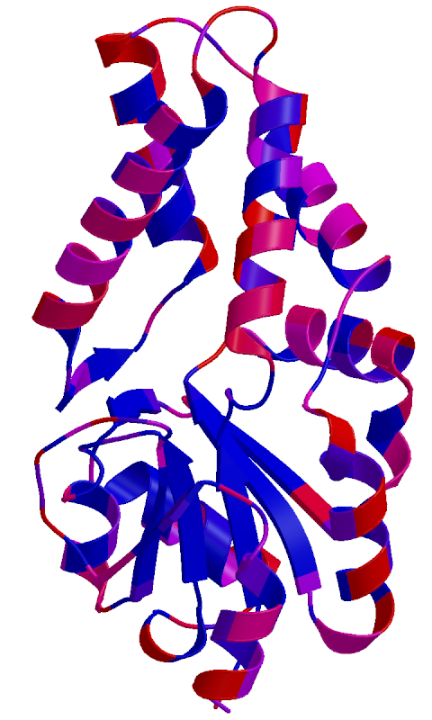
Downweighting
Sequence similarity
(residue level)
Accessible surface area
(atom level)

Slide 60
Model modification in MOLREP
molrep -f data.mtz -m model.pdb -s target.seq
  Performs model correction:
      Identifies secondary structure in the model
      Aligns target and model sequences
        no deletions or insertions in α-helixes or β-strands
      CHAINSAW-like modification
  Adds B-factor to residues exposed to solvent
  Uses sequence identity to down-weight high resolution data

Slide 61
Multi-model strategy
Model
Model
Model
CHAINSAW
Sculptor
Sculptor
+ASA B-factors
Model
Sculptor
+sequence similarity B-factors
Model
Sculptor
+sequence similarity B-factors
+ ASA B-factors

Slide 62
Modern Molecular Replacement
Model generation
online resources
internal databases
Molecular Replacement Search
Refinement
Search in the density
Scoring
Refinement
Model building (SHELXE CA-trace!)

Slide 63


MrBUMP
Ronan Keegan
(CCP4 STFC RAL)
Martyn Winn
(STFC DL)

Slide 64

MrBUMP features
Particular emphasis on generating a variety of search models
Uses a variety of bioinformatics tools and helper applications
Uses on-line databases
Favourable cases: gives “one-button” solution
Complicated cases: lead generation
    (suggests likely search models for manual investigation)

Slide 65
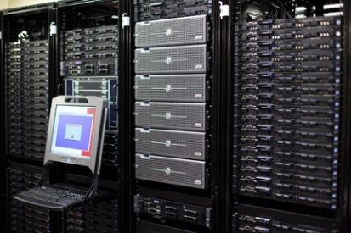
MrBUMP Pipeline
X-ray
data
(MTZ)
Target
sequence
User specified models
Template
search
WEB resources
(FASTA, PDB etc.)
Model
preparation
Programs available from CCP4
Known
partial
structure
Molecular replacement
& refinement
Farm MR/Refinement jobs to cluster
Model building and
Phase improvement

Slide 66
MrBUMP Pipeline
Initial list of model templates
  Sequence based search using target sequence
    FASTA search of the PDB
Model template scoring
  Based on multiple sequence alignment
    ClustalW, MAFFT coming with CCP4
    Probcons, T-coffee optionally installed
X-ray
data
(MTZ)
Target
sequence
User specified models
Template
search
Model
preparation
Known
partial
structure
Molecular replacement
& refinement
Model building and
Phase improvement

Slide 67
MrBUMP Pipeline
Additional model templates
  Monomers
    Search PDBeFold (SSM) for top hits from the initial FASTA search
  Domains if possible
    Domain definitions from SCOP for each initial template
  Homo-multimers if possible
    Multimer definitions manually generated using PISA
X-ray
data
(MTZ)
Target
sequence
User specified models
Template
search
Model
preparation
Known
partial
structure
Molecular replacement
& refinement
Model building and
Phase improvement

Slide 68
MrBUMP Pipeline
Additional model templates
  Monomers
    PDB codes and chain IDs provided by a user
      e.g. from FFAS or psiBLAST searches
    PDB files provided by a user
      e.g. unpublished structures
X-ray
data
(MTZ)
Target
sequence
User specified models
Template
search
Model
preparation
Known
partial
structure
Molecular replacement
& refinement
Model building and
Phase improvement

Slide 69
MrBUMP Pipeline
Search Model Preparation
  Several options for each template
    PDBclip (unmodified)
    Molrep
    Chainsaw
    Sculptor
    polyalanine
  Ensembles if requested
    generated using Superpose from top score search models
X-ray
data
(MTZ)
Target
sequence
User specified models
Template
search
Model
preparation
Known
partial
structure
Molecular replacement
& refinement
Model building and
Phase improvement

Slide 70
MrBUMP Pipeline
Molecular Replacement
  Molrep or Phaser or both for each search model
  Test for enantiomorphic space groups if requested by a user
Restrained Refinement
  Using Refmac for each MR result
    Refinement results are used for scoring MR solutions
X-ray
data
(MTZ)
Target
sequence
User specified models
Template
search
Model
preparation
Known
partial
structure
Molecular replacement
& refinement
Model building and
Phase improvement

Slide 71
Scoring MR solutions
final Rfree < 0.35 or
final Rfree < 0.5 and dropped by 20%
⇒
“good”
final Rfree < 0.48 or
final Rfree < 0.52 and dropped by 5%
⇒
“marginal”
⇒
“poor”
otherwise
conservative approach,
a "poor" solution can still be a solution

Slide 72
MrBUMP Pipeline
Model building
  Buccaneer, ARP/wARP or SHELXE if requested
  Model completeness is used for scoring MR solutions
Phase improvement
  Acorn if resolution is better than 1.7Å
  CC for medium Es is used for scoring MR solutions
X-ray
data
(MTZ)
Target
sequence
User specified models
Template
search
Model
preparation
Known
partial
structure
Molecular replacement
& refinement
Model building and
Phase improvement

Slide 73
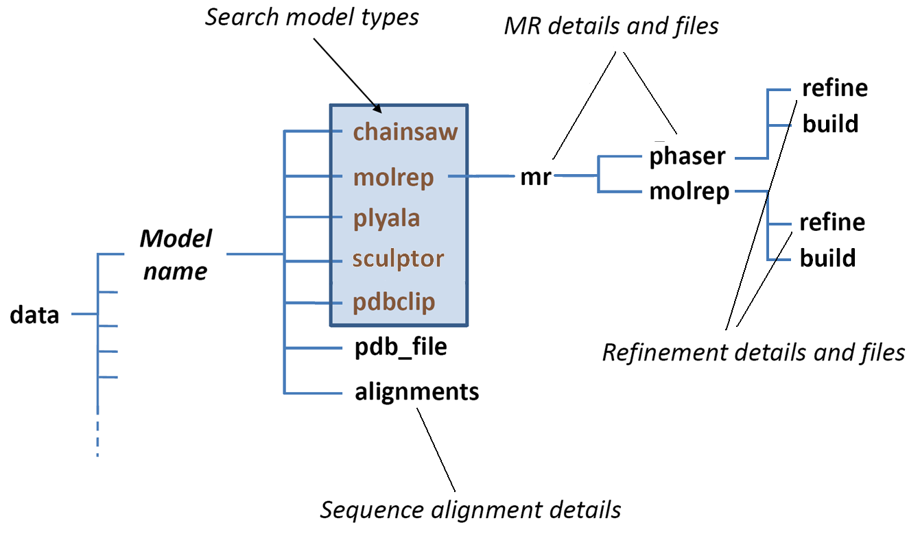
MrBUMP data directory

Slide 74
MrBUMP Testing Results
Model type for best solution

Slide 75
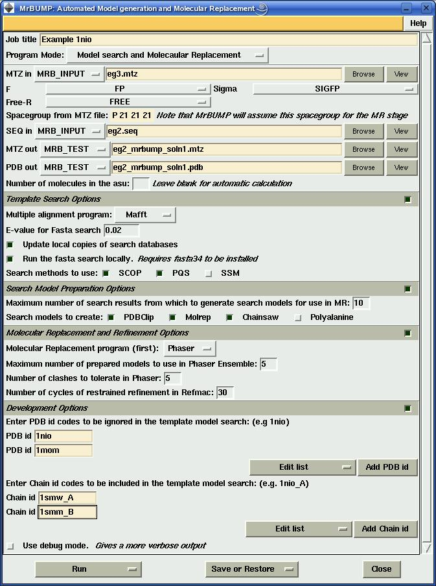
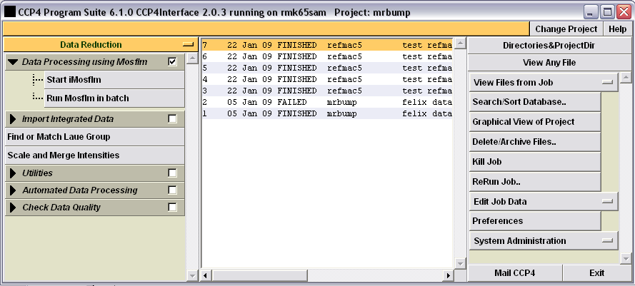
MrBUMP in CCP4i
MrBUMP included in CCP4 suite
Runs on Linux, OSX and Windows.
Comes with CCP4 GUI
Can also be run from the command line with keyword input
Tutorials available

Slide 76
Balbes
Fei Long
Garib Murshudov
MRC LMB Cambridge
Alexey Vagin
YSBL University of York

Slide 77
Balbes features
Input
      mtz-file
      sequence
Output
      the best solution
      search models for manual investigation
  Balbes has a database containing preprocessed data from the PDB
  Structure solution using Molrep and Refmac
      Uses the search in the density for a second, third etc. component

Slide 78
BALBES Pipeline
X-ray
data
(MTZ)
Target
sequence
Template
search
BALBES DB
and associated programs
Model
preparation
Model building
at
ARP/wARP server
Molecular replacement
& refinement
search models
possible solution
possible solution

Slide 79
Database
  Non-redundant chains from the PDB
      The PDB entries of better resolution are preferred
  More than 30000 domain definitions
      flexible parts removed
      hierarchically organized according to 3D similarity
  Multimers
      generated using PISA definition
  Relations
      domain entry points to original PDB ID, chain ID and residues
      multimer entry to original PDB ID, chain IDs

Slide 80
Model preparation
MARPVPEETVATERVKE
  All models are corrected
      by sequence alignment
      by accessible surface area
  Several input sequences mean protein-protein complex
      hetero-multimeric models will be generated if possible
MARPVPEETVATERVKE
Domain models
Multimeric
models
Chain models

Slide 81
Search order
➔ Sequence identity decreases ➔
"Multidomain
model"
"Structure 1"
"Structure 2"
"Structure 3"
"Model 1"
"Model 2"
"Model 3"

Slide 82
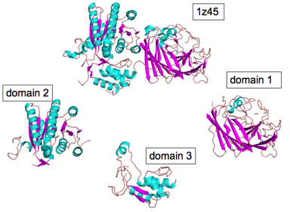
Multi-domain model (test case)
Target
1z45 - isomerase
Multi-domain
model
1yga - domain of isomerase (51%)
1udc - two domains of isomerase (49%)
1ek6 - two domains of isomerase (55%)

Slide 83
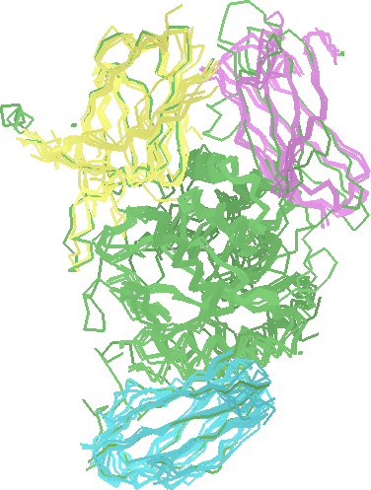
Ensemble models
Ensemble models are generated if possible
Reference chain
Homologues from the Balbes database:
Ensemble search models:
Reference chain
on the top
Notes:
Balbes:
Utilised search in the density for second and next models
(The order of search depends on on whether or not domains are present, sizes of domains, etc)
Yet another important detail: ensemble models

Slide 84
Ensemble models from Balbes

Slide 85


AMPLE
Ab initio Modelling of Proteins for moLEcular replacement
Uses Rosetta to generate ab initio models
Several new structures has been already solved
Jaclyn Bibby, Jens Thomas,
Olga Mayans and Daniel Rigden
Institute of Integrative Biology
Ronan Keegan and Martyn Winn
Collaborative Computational Project 4 (CCP4)

Slide 86
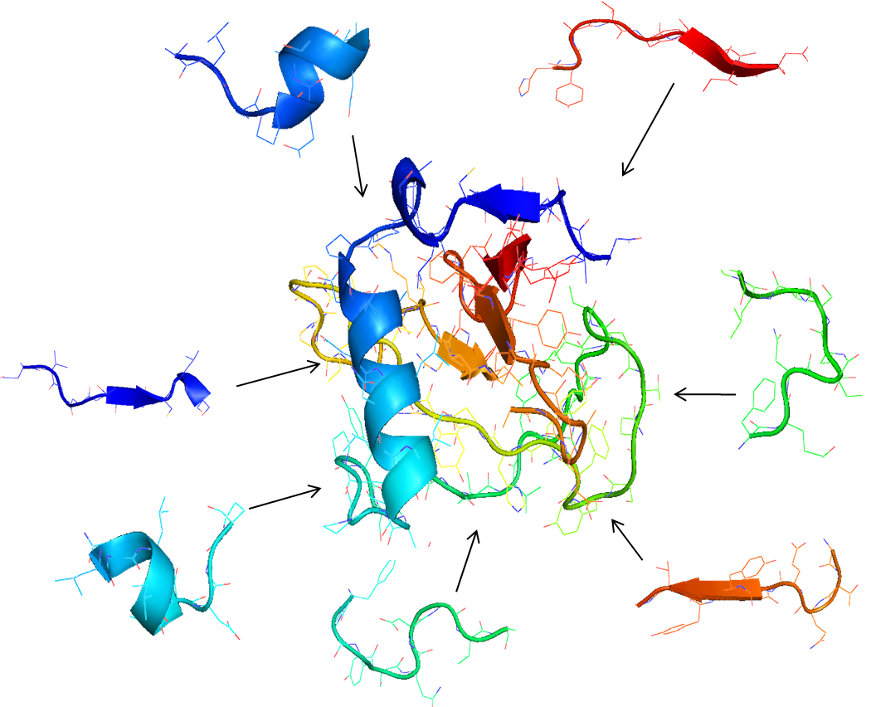
Ab initio structure prediction
Modest computing power is needed:
1000’s of “Decoys” assembled of fragments from PDB structures
Decoys are clustered and centroid representatives of largest cluster are considered candidate fold predictions
Side chains added to selected decoys

Slide 87
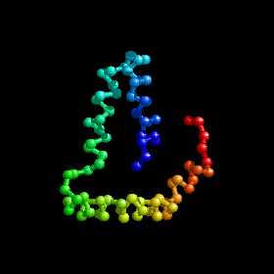
Ab initio structure prediction
Modest computing power is needed:
1000’s of “Decoys” assembled of fragments from PDB structures
Decoys are clustered and centroid representatives of largest cluster are considered candidate fold predictions
Side chains added to selected decoys
Force field refinement
Supercomputing resources are needed:

Slide 88
AMPLE
Modest computing power is needed:
1000’s of “Decoys” assembled of fragments from PDB structures
Decoys are clustered and centroid representatives of largest cluster are considered candidate fold predictions
Side chains added to selected decoys
Ensembles generated from decoy models are used for Molecular Replacement

Slide 89
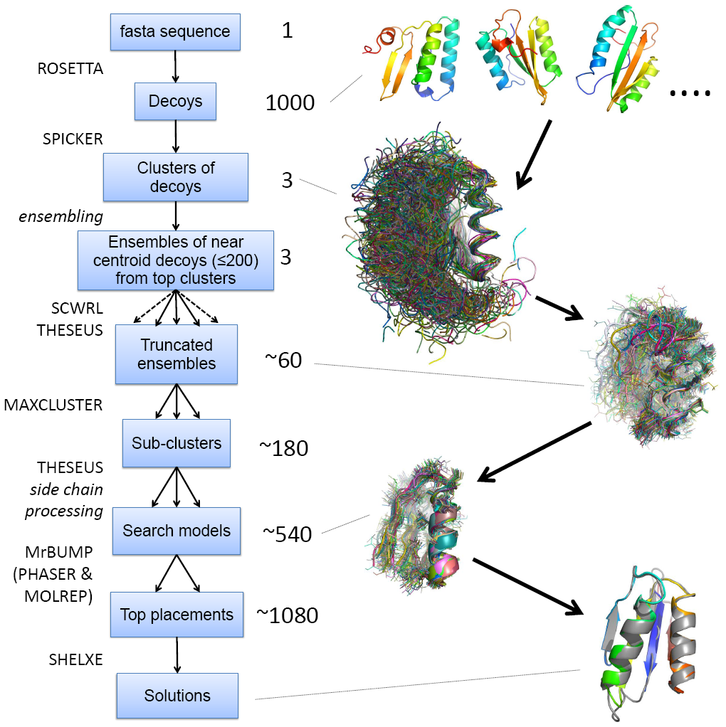

Slide 90
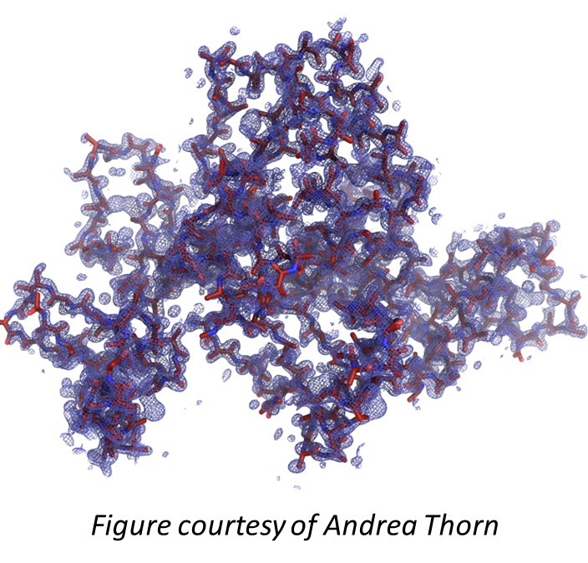
Assessing Solutions
Results of structure rebuilding as a criterion
SHELXE C^{α} tracing
  partial CC of >25%
  average fragment length of 10 or more
Further rebuilding including side chains
  ARP/wARP
  Buccaneer.

Slide 91
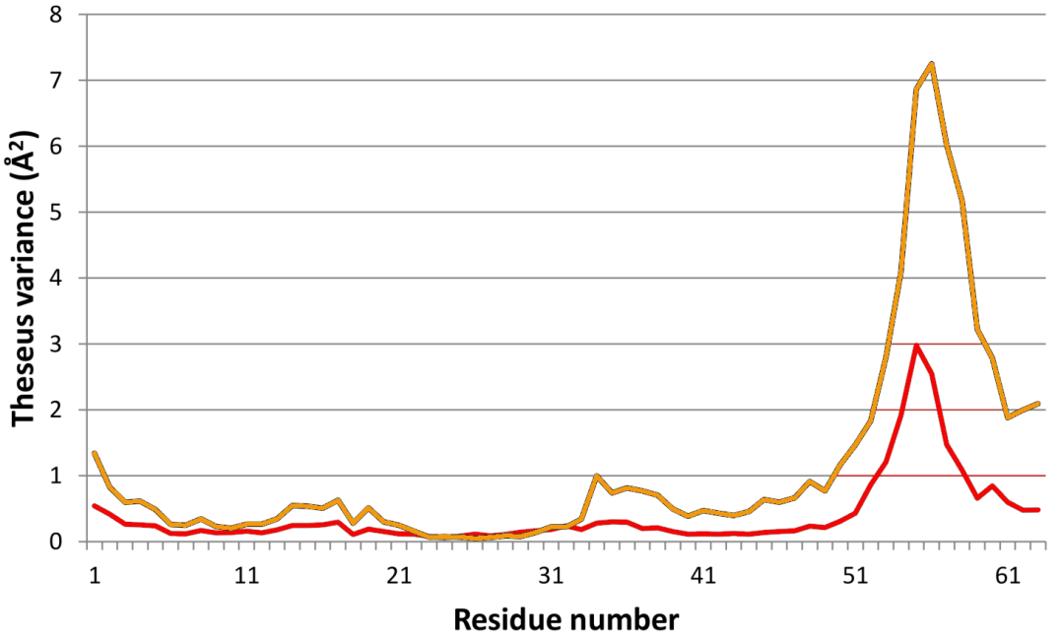
Variance and Truncation
Strong correlation between
  deviation from the true structure
  variability within decoy cluster
2P5K test case
Recipe for model generation:
  truncation at different Theseus variance levels

Slide 92
Synergies
Аb initio modelling | Molecular Replacement
Produces clusters of similar model structures | Works effectively with superposed ensembles
Variance within the cluster correlates with similarity to the target structure | Works most effectively if unreliable parts of model are truncated

Slide 93
Ab initio tests
Test set of 295 small proteins from the PDB (40-120 residues)
Resolution of 2.2 Å or better
Single molecule in the asymmetric unit
Fragment generation step: homologues were excluded
1000 decoys generated for each case using Rosetta
Fold | all-α | all-β | mixed α-β | all cases
Success rate | 80% | 2% | 37% | 43%

Slide 94
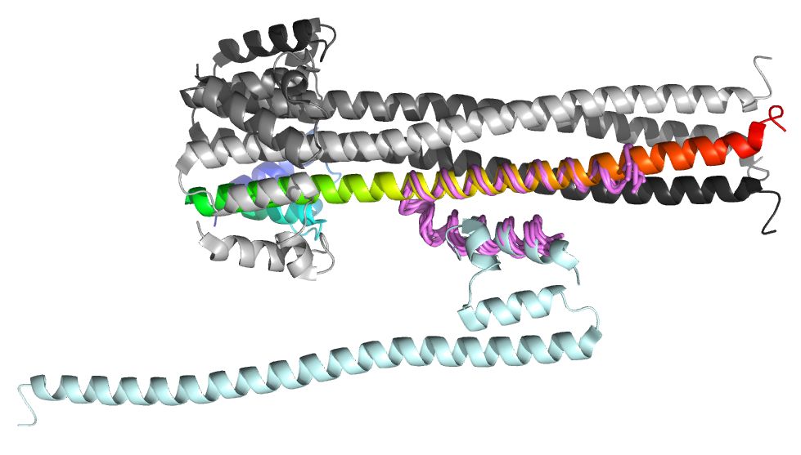
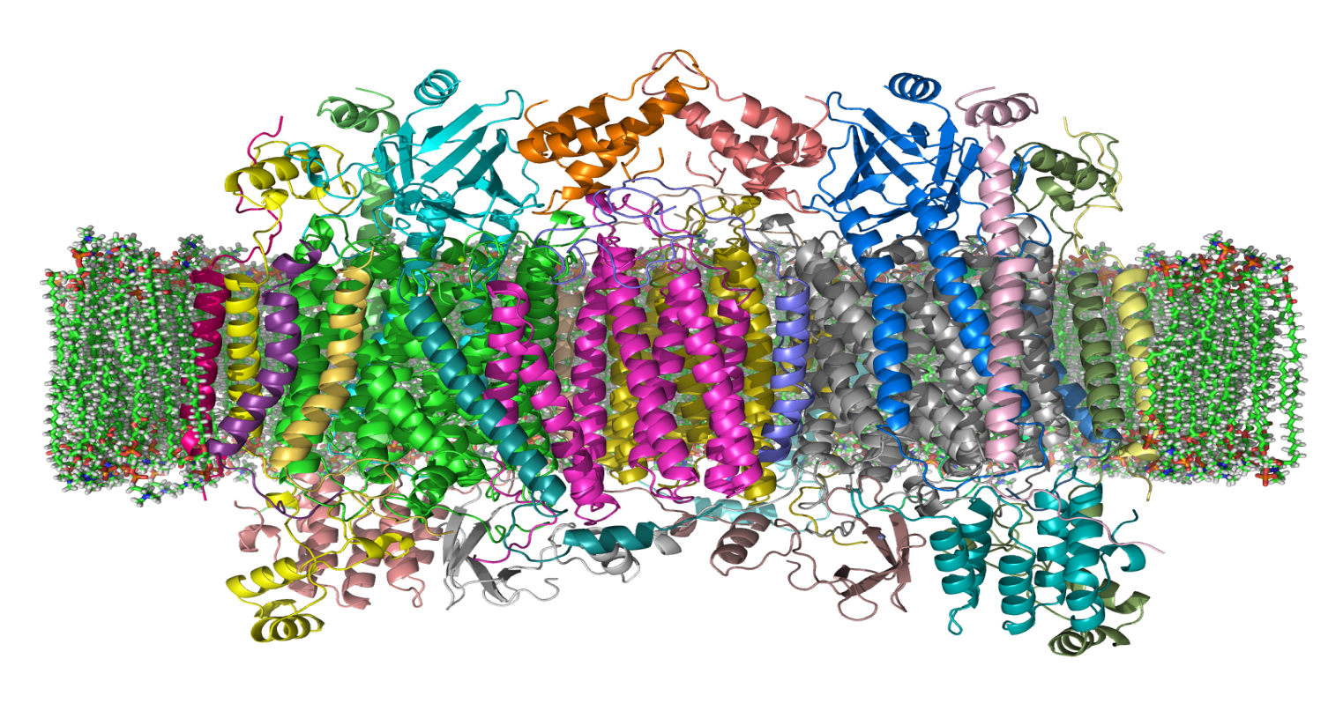
All α-helical proteins are
possible ab-initio targets
Coiled-coil proteins
Difficult to solve in MR even with good homologues
Initial tests: 80% success rate
Some novel structures have also been solved
Transmembrane Proteins
Very difficult to work with/crystallise
18 test cases of 1.45 - 2.5A resolution
7 clear and 5 possible successes
223 residue structure (3GD8) could be largest ever solved ab initio.
  Image: http://en.wikiversity.org/wiki/File:Cytochrome_C_Oxidase_1OCC_in_Membrane_2.png

Slide 95
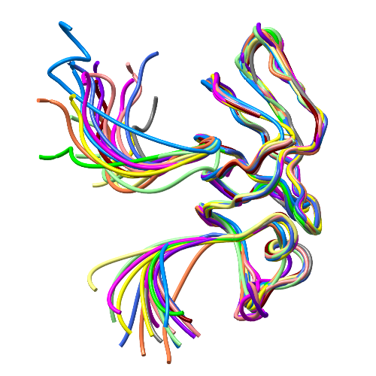
General targets
AMPLE can use Rosetta to “re-model” a particular set of templates
Remodelling related NMR structures
Exploiting distant homologues

Slide 96
AMPLE usage
Complete run: 2 CPU days
A parallelised version on a cluster: 1 hour
Distributed as a part of CCP4 suite
6.3.0: beta version
6.4.0 (upcoming and installed here): improved and more robust version
Currently required non-CCP4 packages:
  Rosetta, SHELXE, Theseus, SPICKER, Maxcluster

Slide 97



Documentation available from http://ccp4wiki.org

Slide 98
Acknowledgements
AmoRe
Jorge Navaza IBS Grenoble
Molrep
Alexey Vagin University of York
  Phaser
  Randy Read University of Cambridge
  Airlie McCoy University of Cambridge
  Gabor Bunkozci University of Cambridge

Slide 99
Acknowledgements
Balbes
Alexey Vagin University of York
Fei Long MRC LMB
Garib Murshudov MRC LMB
MrBUMP
Ronan Keegan STFC RAL
Martyn Winn STFC DL
Ample
Ronan Keegan STFC RAL
Jaclyn Bibby University of Liverpool
Daniel Rigden University of Liverpool
Olga Mayans University of Liverpool

